Slide 1
Multi Disciplinary Course (MDC)
Mathematical Science
MDC-1: Foundation Of Mathematical Science -- I
For FYUGP 1st Semester(Unit III -- Statistics)
By
R K Bhuyan,
HoD, DoM & Vic-Principal
Tihu College, Tihu
Class No 2

Slide 2
Scope and Importance of Statistics
Statistics is a branch of mathematics that deals with the collection, analysis, interpretation, and presentation of data. It provides the tools and methods necessary to make sense of large amounts of information and draw meaningful conclusions. Its scope is vast, and its applications are found in nearly every field of study.

Slide 3
Scope and Importance
The scope of statistics is broad, and it is a crucial tool in modern decision-making, research, and policy formulation.
It allows us to:
Organize and summarize data: Statistics helps to condense large datasets into manageable and understandable summaries, like averages, percentages, and graphs.

Slide 4
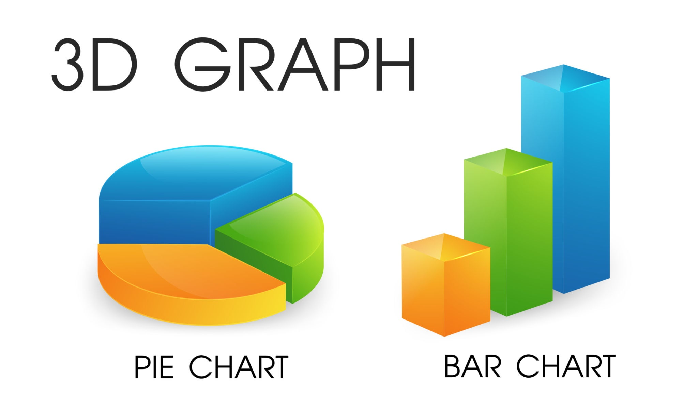

Slide 5
Draw inferences: It enables us to make educated guesses or predictions about a larger population based on a smaller, representative sample. This is fundamental to scientific research and market analysis.
Identify relationships and trends: By analyzing data, statisticians can uncover hidden patterns, correlations, and trends that can inform business strategy, public health initiatives, and economic forecasts.
Test hypotheses: It provides a structured, scientific method for testing theories and claims, such as the effectiveness of a new drug or the impact of a new government policy.

Slide 6
Limitations 🧐
Despite its immense utility, statistics has several key limitations that must be understood to avoid misuse and misinterpretation:
It only deals with quantitative data: Statistics cannot directly analyze qualitative characteristics like honesty, beauty, or intelligence unless they are converted into a numerical format, such as through a scoring system.
It doesn't study individual cases: Statistical conclusions are based on averages and aggregates of facts, not on specific individual instances. The average height of people in a country doesn't tell you the height of any one person.

Slide 7
Limitations 🧐
Results are true only on average: Statistical laws are not universally true like those in physics or chemistry. They are based on probability and are true in the long run or on average, which means there's always a chance for variation.
It can be misused: Statistics can be manipulated or presented in a misleading way to support a desired conclusion, often without providing the full context. This can lead to false or fallacious arguments

Slide 8
Applications in Other Fields
Statistics is an indispensable tool in a wide range of fields, including:
Business and Economics: Used for market research, financial forecasting, quality control, and risk management. Businesses use statistics to understand consumer behavior and make data-driven decisions about products and marketing.
Healthcare and Medicine: Essential for clinical trials to test the efficacy of new drugs and treatments. It's also used in epidemiology to study the spread of diseases, assess public health risks, and manage patient data.
Government and Public Policy: Governments rely on statistics from sources like censuses to make informed decisions about resource allocation, infrastructure, and social programs. It's used to analyze population growth, unemployment rates, and inflation.

Slide 9
Applications in Other Fields
Science and Research: Statistics is the backbone of scientific research. It helps scientists design experiments, analyze experimental data, and draw valid conclusions. This applies to fields from biology and chemistry to astronomy and environmental science.
Social Sciences: Used in sociology and psychology to analyze human behavior, social trends, and survey data. It helps researchers understand complex social phenomena, such as public opinion on a political issue or the factors contributing to educational success.
Sports: Professional sports teams use statistical analysis (like Sabermetrics in baseball) to evaluate player performance, develop game strategies, and inform recruitment decisions.

Slide 10
Roles of computers in statistic
Computers play an indispensable role in modern statistics by automating and accelerating the entire data analysis process. They have transformed the field from manual, labour-intensive calculations to powerful, data-driven insights.

Slide 11
Primary Roles of Computers in Statistics 💻
Data Handling and Management: Computers are essential for collecting, organizing, and storing vast amounts of data. Databases and spreadsheets allow statisticians to manage large, complex datasets that would be impossible to handle manually.
Performing Complex Calculations: Computers can perform complex statistical calculations with incredible speed and accuracy. Regression analysis, hypothesis testing, and time series analysis are more advance statistics.

Slide 12
Data Visualization: Computers enable the creation of sophisticated and dynamic visualizations. Statistical software can generate a wide array of charts and graphs, including scatter plots, histograms, and heat maps. These visual representations help statisticians and others to easily identify patterns, trends, and outliers in the data, making it easier to communicate findings.
Simulation and Modeling: Computers are crucial for running simulations and creating statistical models. These simulations are used to model complex systems, from financial markets to disease spread.
Automation of Repetitive Tasks: With programming languages like R and Python, statisticians can automate repetitive analytical tasks. This ensures reproducibility and reduces the chance of human error.

Slide 13
Statistical Software and Programming Languages
A wide range of software and programming languages has been developed to leverage the power of computers for statistical work:
R and Python: These are open-source programming languages with extensive libraries for statistical analysis (e.g., NumPy, Pandas, Scikit-learn in Python; ggplot2, tidyverse in R). They are highly popular in academia and data science for their flexibility and power.
SPSS (Statistical Package for the Social Sciences): A commercial software widely used in the social sciences for its user-friendly, graphical interface, which simplifies data analysis for those who aren't experts in coding.
SAS (Statistical Analysis System): Another powerful commercial software used heavily in business and government for its robust data management and advanced analytical capabilities.
Stata: A commercial statistical software package primarily used in economics, political science, and biomedical research, known for its extensive set of built-in commands and easy-to-use interface.

Slide 14
Statistical Data Types
Statistical data can be broadly classified into two main types:
Qualitative :- Qualitative data is non-numerical. Examples include gender (male, female), marital status (single, married), or blood type (A, B, AB, O).
and
Quantitative :- while quantitative data is numerical. Examples include the number of students in a class or the number of cars in a parking lot.

Slide 15
Methods of Data Collection ✍️
Data collection is the process of gathering and measuring information from various sources to get a complete picture of a specific topic. The two main types of data collection are primary and secondary.
Primary Data Collection: This is the process of collecting original, firsthand data specifically for your research purpose.
Secondary Data Collection: This involves using data that has already been collected and published by someone else for a different purpose.

Slide 16
Primary Data Collection:
Surveys and Questionnaires: One of the most common methods, used to collect data by asking a series of questions to a group of people. This can be done online, in person, or by mail.
Interviews: Involve direct, one-on-one conversations with individuals to gather in-depth, qualitative information about their opinions, experiences, or knowledge.
Observations: The researcher observes and records behaviours or events as they naturally occur in a specific setting. This method is useful for studying human behaviour or processes.
Experiments: A controlled method where researchers manipulate one or more variables to see how they affect others. This is common in scientific research to test hypotheses and establish cause-and-effect relationships

Slide 17
Secondary Data Collection:
Published Sources: This includes data found in government publications (like census reports), academic journals, books, and public company records.
Internal Sources: This refers to data that is already within an organization, such as sales records, customer transaction data, and employee reports.
External Sources: This includes data from third-party sources, like market research reports, professional organizations, and trade publications.
https://youtu.be/OeF93Q8gPsM

Slide 18
General Concepts
Que1: What is statistics?
Ans: Statistics is the science of collecting, analyzing, interpreting, and presenting data. It helps us make sense of information and draw conclusions about a larger population based on a smaller sample.
Que2:What is the main difference between qualitative and quantitative data?
Ans: Qualitative data is non-numerical and describes characteristics (like colors or opinions),
while quantitative data is numerical and represents counts or measurements (like height or temperature).

Slide 19
Scope and Limitations
Que3: What are two key applications of statistics in the real world?
Ans: Statistics is used in:
Business to forecast sales and analyze market trends.
Medicine to test the effectiveness of new drugs through clinical trials.
Que4: What is a major limitation of statistics?
Ans: A major limitation is that statistical conclusions are based on averages and may not apply to any individual case. It also cannot analyze subjective qualities unless they are converted into numbers.

Slide 20
Data Types and Collection
Que5: What is the difference between discrete and continuous data?
Ans: Discrete data consists of whole numbers that are counted (e.g., number of students).
Continuous data can take any value within a range and is measured (e.g., a person's height).
Que6: What is the difference between primary and secondary data collection?
Ans: Primary data is original, first-hand data collected specifically for a research purpose (e.g., conducting a survey).
Secondary data is data that has already been collected by someone else and is being used again (e.g., using government census data).

Slide 21
Role of Computers
Que7: How have computers changed the field of statistics?
Ans: Computers have revolutionized statistics by allowing for the fast and accurate analysis of massive datasets, automating complex calculations, and enabling sophisticated data visualization.
Que8: Name two common software tools used for statistical analysis.
Ans: R and Python are widely used for statistical analysis due to their powerful libraries and capabilities. Other tools include SPSS and SAS, which are often used in business and social sciences.

