Slide 1

Multi Disciplinary Course (MDC)
Mathematical Science
MDC-III: Foundation Of Mathematical Science -- III
For FYUGP 3rd Semester
By
R K Bhuyan,
HoD, DoM & Vic-Principal
Tihu College, Tihu
Class No 1

Slide 2
Course Learning Out comes:
This course will enable the students to:
(i) Have knowledge and critical understanding, visualization, of basic concepts, terms of sets.
(ii) Know about counting principle.
(iii) Learn about relation and functions.
(iv) Learn matrices and determinants, solving systems of linear equations through determinants.
(v) Learn about derivative of different type of functions and application of derivative in economics.
(vi) Know about sample spaces, basic ideas of probability and its application in practical problems.

Slide 3
UNIT-IV: Probability:
Idea of Probability generating function and characteristic function and its utility in statistics.
Probability generating functions (PGFs) and characteristic functions (CFs) --
- are mathematical tools used in probability and statistics to represent a random variable's probability distribution in a different form.
They're particularly useful because they simplify certain operations, especially when dealing with sums of independent random variables.

Slide 4
Probability Generating Function (PGF)
A probability generating function, often denoted as G_{X}​(t), is a power series that encodes the probability mass function of a discrete random variable that takes on non-negative integer values.
The PGF for a random variable X is defined as:
G_{X}​(t)=E[t^{X}]=∑_{x=0}∞​P(X=x)t^{x}
The key idea is that the coefficients of the power series are the probabilities of the random variable taking on a specific value. For example, the coefficient of t^{k} in the series is P(X=k).

Slide 5
Utility of PGFs
Simplifying sums: The PGF of a sum of independent random variables is the product of their individual PGFs. This property, known as the convolution theorem, significantly simplifies finding the distribution of a sum of random variables.
Finding moments: You can find the moments of a distribution, like the mean and variance, by differentiating the PGF. For example, the mean E[X] is G_{X}′​(1) and the variance Var(X) can be calculated from the first and second derivatives evaluated at t=1.
Proof of theorems: PGFs are used to prove results in probability, such as the Central Limit Theorem for certain distributions.

Slide 6

Characteristic Function (CF)
A characteristic function, denoted as ϕ_{X}​(t), is a function that uniquely defines the probability distribution of any real-valued random variable, whether discrete or continuous. It's a complex-valued function and is essentially a type of Fourier transform of the probability distribution. The CF for a random variable X is defined as:
ϕ_{X}​(t)=E[e^{itX}]=E[cos(tX)+isin(tX)]
Here, i is the imaginary unit (i²=−1).

Slide 7
Utility of CFs
Universal Existence: The CF always exists for any random variable, unlike the moment-generating function which may not exist for some distributions. This makes it a more general tool.
Uniqueness: A distribution is uniquely determined by its characteristic function. If two random variables have the same CF, they have the same distribution. This is a powerful property for proving that two distributions are identical.
Simplifying sums: Similar to PGFs, the characteristic function of a sum of independent random variables is the product of their individual CFs. This property is crucial for analysing sums and is fundamental to the proof of the Central Limit Theorem.
Finding moments: The moments of a distribution can be obtained by taking derivatives of the CF and evaluating them at t=0.

Slide 8
In short
Both functions act as a kind of "fingerprint" for a probability distribution, allowing for simpler algebraic manipulation (products instead of convolutions) and providing a way to derive important properties like moments.
The PGF is limited to discrete, non-negative integer variables, while the CF is more general and applies to all types of random variables.

Slide 9
Questions and Answers
Que 1. What is a probability generating function (PGF)?
Ans :-A probability generating function, G_{X}​(t), is a power series where the coefficients are the probabilities of a discrete random variable taking on non-negative integer values. It's a convenient way to represent the entire probability distribution in a single function.
G_{X}​(t)=E[t^{X}]=∑_{x=0}∞​P(X=x)t^{x}
For example, for a random variable X that can take values 0, 1, and 2 with probabilities P(X=0)=0.2, P(X=1)=0.5, and P(X=2)=0.3,
the PGF is G_{X}​(t)=0.2t⁰+0.5t¹+0.3t²=0.2+0.5t+0.3t².

Slide 10
Que 2 : How are PGFs used to find moments of a distribution?
Ans :-You can find the moments of a distribution by differentiating its PGF. The mean (first moment) is the first derivative evaluated at t=1, and the variance can be derived from the first and second derivatives evaluated at t=1.
Mean: E[X]=G_{X}′​(1)
Variance: Var(X)=G_{X}′′​(1)+G_{X}′​(1)−(G_{X}′​(1))²
For the example above, the mean is G_{X}′​(t)∣_{t=1}​=(0.5+0.6t)∣_{t=1}​=0.5+0.6=1.1

Slide 11
Que 3 :What is a characteristic function (CF)?
Ans :- A characteristic function, ϕ_{X}​(t), is a complex-valued function that uniquely determines the probability distribution of any random variable (discrete, continuous, or a mixture). It's essentially the Fourier transform of the probability distribution.
ϕ_{X}​(t)=E[e^{itX}]=E[cos(tX)+ i sin(tX)]

Slide 12
Que 4: Why are characteristic functions more versatile than moment generating functions?
Ans :- The characteristic function always exists for any random variable, while the moment generating function may not.
For example, the Cauchy distribution has a well-defined characteristic function but its moment generating function does not exist. This makes the CF a more general and powerful tool in theoretical statistics.

Slide 13
Que 5 : How are PGFs and CFs used to analyse sums of independent random variables?
One of the most powerful properties of both functions is that the generating function of a sum of independent random variables is the product of their individual generating functions.
For PGFs: If X and Y are independent, G_{X+Y}​(t)=G_{X}​(t)G_{Y}​(t).
For CFs: If X and Y are independent, ϕ_{X+Y}​(t)=ϕ_{X}​(t)ϕ_{Y}​(t).

Slide 14
Random Experiment
A random experiment is an activity or process with a set of well-defined outcomes that cannot be predicted with certainty before the experiment is performed. In other words, you know all the possible results, but you don't know which one you'll get on a single trial. 🎲
Every random experiment has two essential conditions:
  It can be repeated multiple times under the same conditions.
  The outcome of each repetition cannot be predicted in advance.
The collection of all possible outcomes of a random experiment is called the sample space.

Slide 15
Examples of Random Experiments
Simple Experiments :-
These are basic, classic examples used to illustrate the concepts of probability.
Tossing a fair coin: The experiment is flipping a coin. The possible outcomes are heads (H) or tails (T). You can't know for sure which one you'll get. The sample space is S = {H, T}.
Rolling a standard six-sided die: The experiment is rolling the die. The possible outcomes are the numbers 1, 2, 3, 4, 5, or 6. You don't know which number will show up. The sample space is S = {1, 2, 3, 4, 5, 6}.
Drawing a card from a deck: The experiment is selecting a single card from a well-shuffled deck of 52 cards. The outcome is which of the 52 cards you draw. The sample space consists of all 52 cards.

Slide 16
More Complex Experiments
Random experiments can be combining multiple simple experiments.
Tossing a coin three times: The experiment involves three sequential coin flips. The outcomes are sequences of H and T. The sample space is S = {HHH, HHT, HTH, THH, HTT, THT, TTH, TTT}.
Rolling two dice: The experiment is rolling a pair of dice. The outcome is an ordered pair of the numbers shown on each die. The sample space contains 36 possible outcomes, from (1,1) to (6,6).

Slide 17
Sample Space
A sample space, denoted by S, is the set of all possible outcomes of a random experiment. Each individual outcome in the sample space is called a sample point. It's the complete list of everything that could possibly happen, without any duplicates

Slide 18
Examples of Sample Spaces
Rolling a single six-sided die: The experiment is rolling the die. The possible outcomes are the numbers on the faces. The sample space is a set of these numbers: S={1,2,3,4,5,6}
Flipping a fair coin: The experiment is tossing the coin. There are two possible outcomes: heads or tails. The sample space is: S={Heads, Tails} or simply S={H,T}
Drawing a single card from a standard deck: The experiment is selecting a card. The sample space consists of all 52 cards, where each card is a unique outcome.

Slide 19
Combining multiple simple experiments
Flipping a coin twice: The experiment involves two sequential events. The outcomes are ordered pairs of results from each flip. The sample space is: S={(H,H),(H,T),(T,H),(T,T)}
Rolling two six-sided dice: The experiment is rolling two dice, say one red and one green. The outcomes are ordered pairs of numbers, where the first number is from the red die and the second is from the green. The sample space contains 36 possible outcomes: S={(1,1),(1,2),…,(1,6),(2,1),…,(6,6)}

Slide 20
Applications
The concept of a sample space is fundamental to probability because it serves as the denominator for calculating probabilities. The probability of an event (a subset of the sample space) is the number of favourable outcomes divided by the total number of outcomes in the sample space.

Slide 21
Events
In probability, an event is a specific subset of the sample space. It represents one or more outcomes of a random experiment that we're interested in.
For example, when you roll a standard six-sided die, the sample space is S={1,2,3,4,5,6}.
An event could be "getting an even number." This event, let's call it A, would be the subset A={2,4,6}. Another event, B, could be "getting a number greater than 4," which is the subset B={5,6}

Slide 22
Algebra of Events
Just like we can perform operations on numbers in algebra, we can perform operations on events using set theory. This is the algebra of events. The results of these operations are new events (subsets of the sample space).
1. Union of Events (A∪B)
The union of two events A and B is the event that occurs if A or B or both occur. It's the set of all outcomes that are in A, or in B, or in both.
Notation: A∪B
Example: Using the die roll, if event A is "getting an even number" (A={2,4,6}) and event B is "getting a number greater than 4" (B={5,6}), the event A∪B is "getting an even number or a number greater than 4."A∪B={2,4,6}∪{5,6}={2,4,5,6}
2. Intersection of Events (A∩B)
The intersection of two events A and B is the event that occurs if both A and B occur. It's the set of all outcomes that are common to both A and B.
Notation: A∩B
Example: With the same events A and B from above, the event A∩B is "getting an even number and a number greater than 4." A∩B={2,4,6}∩{5,6}={6} The only outcome that satisfies both conditions is rolling a 6.

Slide 23
3. Complementary Event (A′)
The complement of an event A is the event that A does not occur. It includes all the outcomes in the sample space that are not in A.
Notation: A′ or A^{c}
Example: For event A ("getting an even number"), the complementary event A′ is "not getting an even number," which is the same as "getting an odd number." A′=S−A={1,2,3,4,5,6}−{2,4,6}={1,3,5}
4. Mutually Exclusive (Disjoint) Events
Two events A and B are mutually exclusive if they cannot happen at the same time. This means their intersection is the empty set (a set with no outcomes).
Notation: A∩B=∅
Example: The events "getting an even number" (A={2,4,6}) and "getting an odd number" (C={1,3,5}) are mutually exclusive because you can't roll a number that is both even and odd. A∩C=∅

Slide 24
Question and Answers :
Que 1. What is a Random Experiment?
Ans :- A random experiment is a process with well-defined outcomes that can't be predicted with certainty beforehand. You know all the possible results, but not which one will occur in a single trial.
Example 1: Tossing a fair coin. The outcomes are heads or tails, but you don't know which one you'll get.
Example 2: Rolling a standard six-sided die. The outcomes are the numbers 1, 2, 3, 4, 5, or 6, but the result of any single roll is uncertain.

Slide 25
Que 2 : What is a Sample Space?
Ans :- A sample space is the set of all possible outcomes of a random experiment. It's often denoted by the symbol S. Each individual outcome in the set is called a sample point.
Example 1: For rolling a single six-sided die, the sample space is S={1,2,3,4,5,6}.
Example 2: For tossing a coin three times, the sample space is S={HHH,HHT,HTH,THH,HTT,THT,TTH,TTT}. Each element in the set is a sample point.

Slide 26
Que 3 : What is an Event?
An event is a specific subset of the sample space. It's a collection of one or more outcomes that you are interested in.
Example 1: For rolling a die, let the event be "getting an even number." This event, let's call it A, is the subset of the sample space A={2,4,6}.
Example 2: For tossing a coin three times, the event could be "getting at least two heads." This event, B, is the subset B={HHT,HTH,THH,HHH}.

Slide 27
Que 4: What is the Mutually Exclusive Events ?
Mutually Exclusive Events
Two events are mutually exclusive (or disjoint) if they cannot happen at the same time. Their intersection is the empty set, ∅.
Example: The events "getting an even number" and "getting an odd number" are mutually exclusive because you can't roll a number that is both even and odd.

Slide 28
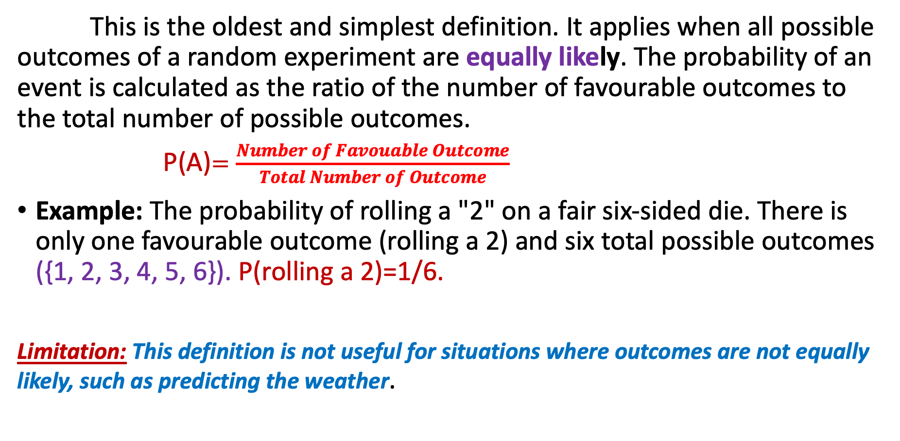
1.Classical Definition(or a Priori)of Probability
This is the oldest and simplest definition. It applies when all possible outcomes of a random experiment are equally likely. The probability of an event is calculated as the ratio of the number of favourable outcomes to the total number of possible outcomes.
P(A)$=\frac{Number of Favouable Outcome}{Total Number of Outcome}$
Example: The probability of rolling a "2" on a fair six-sided die. There is only one favourable outcome (rolling a 2) and six total possible outcomes ({1, 2, 3, 4, 5, 6}). P(rolling a 2)=1/6.
Limitation: This definition is not useful for situations where outcomes are not equally likely, such as predicting the weather.

Slide 29
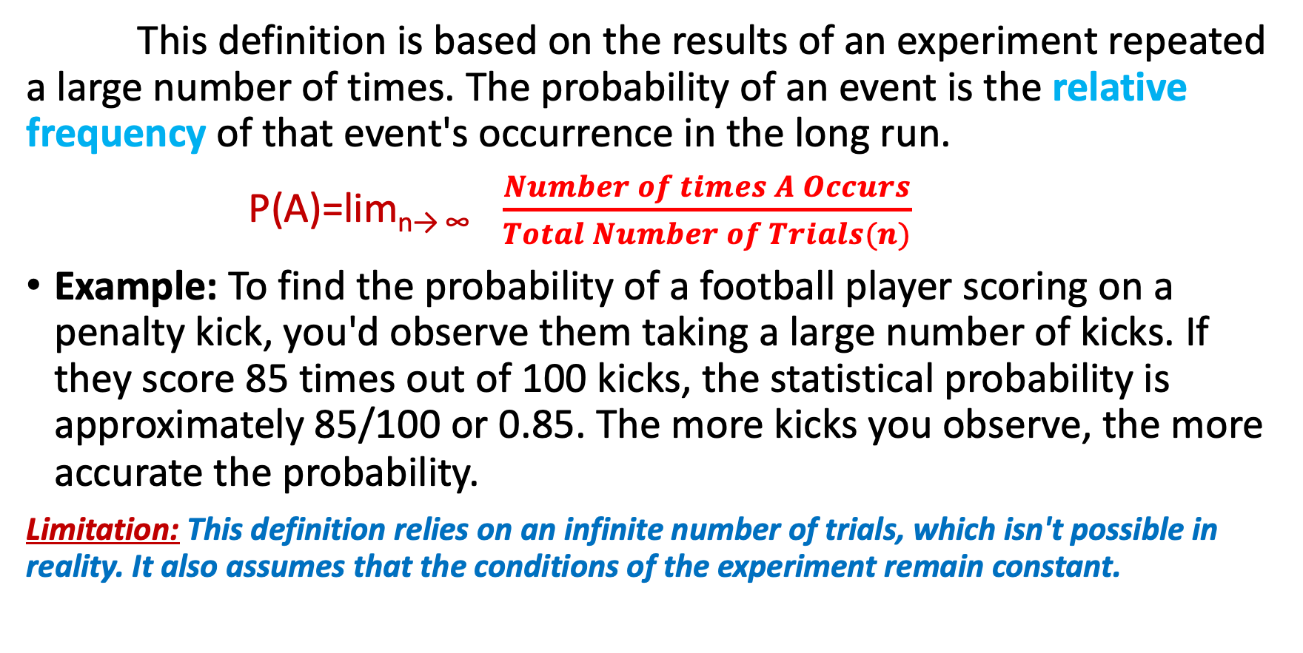
2.Statistical Definition (or Empirical or a Posteriori) of Probability
This definition is based on the results of an experiment repeated a large number of times. The probability of an event is the relative frequency of that event's occurrence in the long run.
P(A)=lim_{n→ ∞} $\frac{Number of times A Occurs}{Total Number of Trials(n)}$ ​
Example: To find the probability of a football player scoring on a penalty kick, you'd observe them taking a large number of kicks. If they score 85 times out of 100 kicks, the statistical probability is approximately 85/100 or 0.85. The more kicks you observe, the more accurate the probability.
Limitation: This definition relies on an infinite number of trials, which isn't possible in reality. It also assumes that the conditions of the experiment remain constant.

Slide 30
3.Axiomatic Definition of Probability
This is the most rigorous and modern approach, introduced by Andrey Kolmogorov. It defines probability using a set of formal rules or axioms, rather than relying on equally likely outcomes or repeated experiments. This definition works for all types of random variables and events. The probability of an event is a number that satisfies the following three axioms:
Non-negativity: The probability of any event A is a non-negative real number. P(A)≥0.
Normalization: The probability of the entire sample space S (the event that is certain to occur) is 1. P(S)=1.
Additivity: For any two mutually exclusive events A and B, the probability of their union is the sum of their individual probabilities. P(A∪B)=P(A)+P(B).

Slide 32
In probability and statistics, we often encounter three types of questions:
What is a random variable?
How do we categorize them? (e.g., discrete vs. continuous)
How do we describe their behavior? (e.g., a probability distribution)

Slide 33
What Is a Random Variable?
A random variable is a function that assigns a numerical value to each outcome of a random experiment. 🔢 It's a way to turn non-numerical outcomes (like "heads" or "tails") into numbers that we can work with mathematically.
Example: In the experiment of tossing a coin three times, the sample space is S=HHH,HHT,HTH,THH,HTT,THT,TTH,TTT. If we define the random variable X as the "number of heads" in the three tosses, then X assigns a number to each outcome:
  X(TTT)=0
  X(HTT)=X(THT)=X(TTH)=1
  X(HHT)=X(HTH)=X(THH)=2
  X(HHH)=3

Slide 34
Discrete Random Variables
Random variables are classified into two main types based on the set of values they can assume.
Discrete Random Variable: A variable that can take on a finite or countably infinite number of distinct values.These variables typically represent counts. There are clear gaps between the possible values.
  Example: The number of children in a family (you can't have 2.5 children).
  Example: The number of defective items in a batch.
  Example: The result of rolling a die (1,2,3,4,5,6).

Slide 35
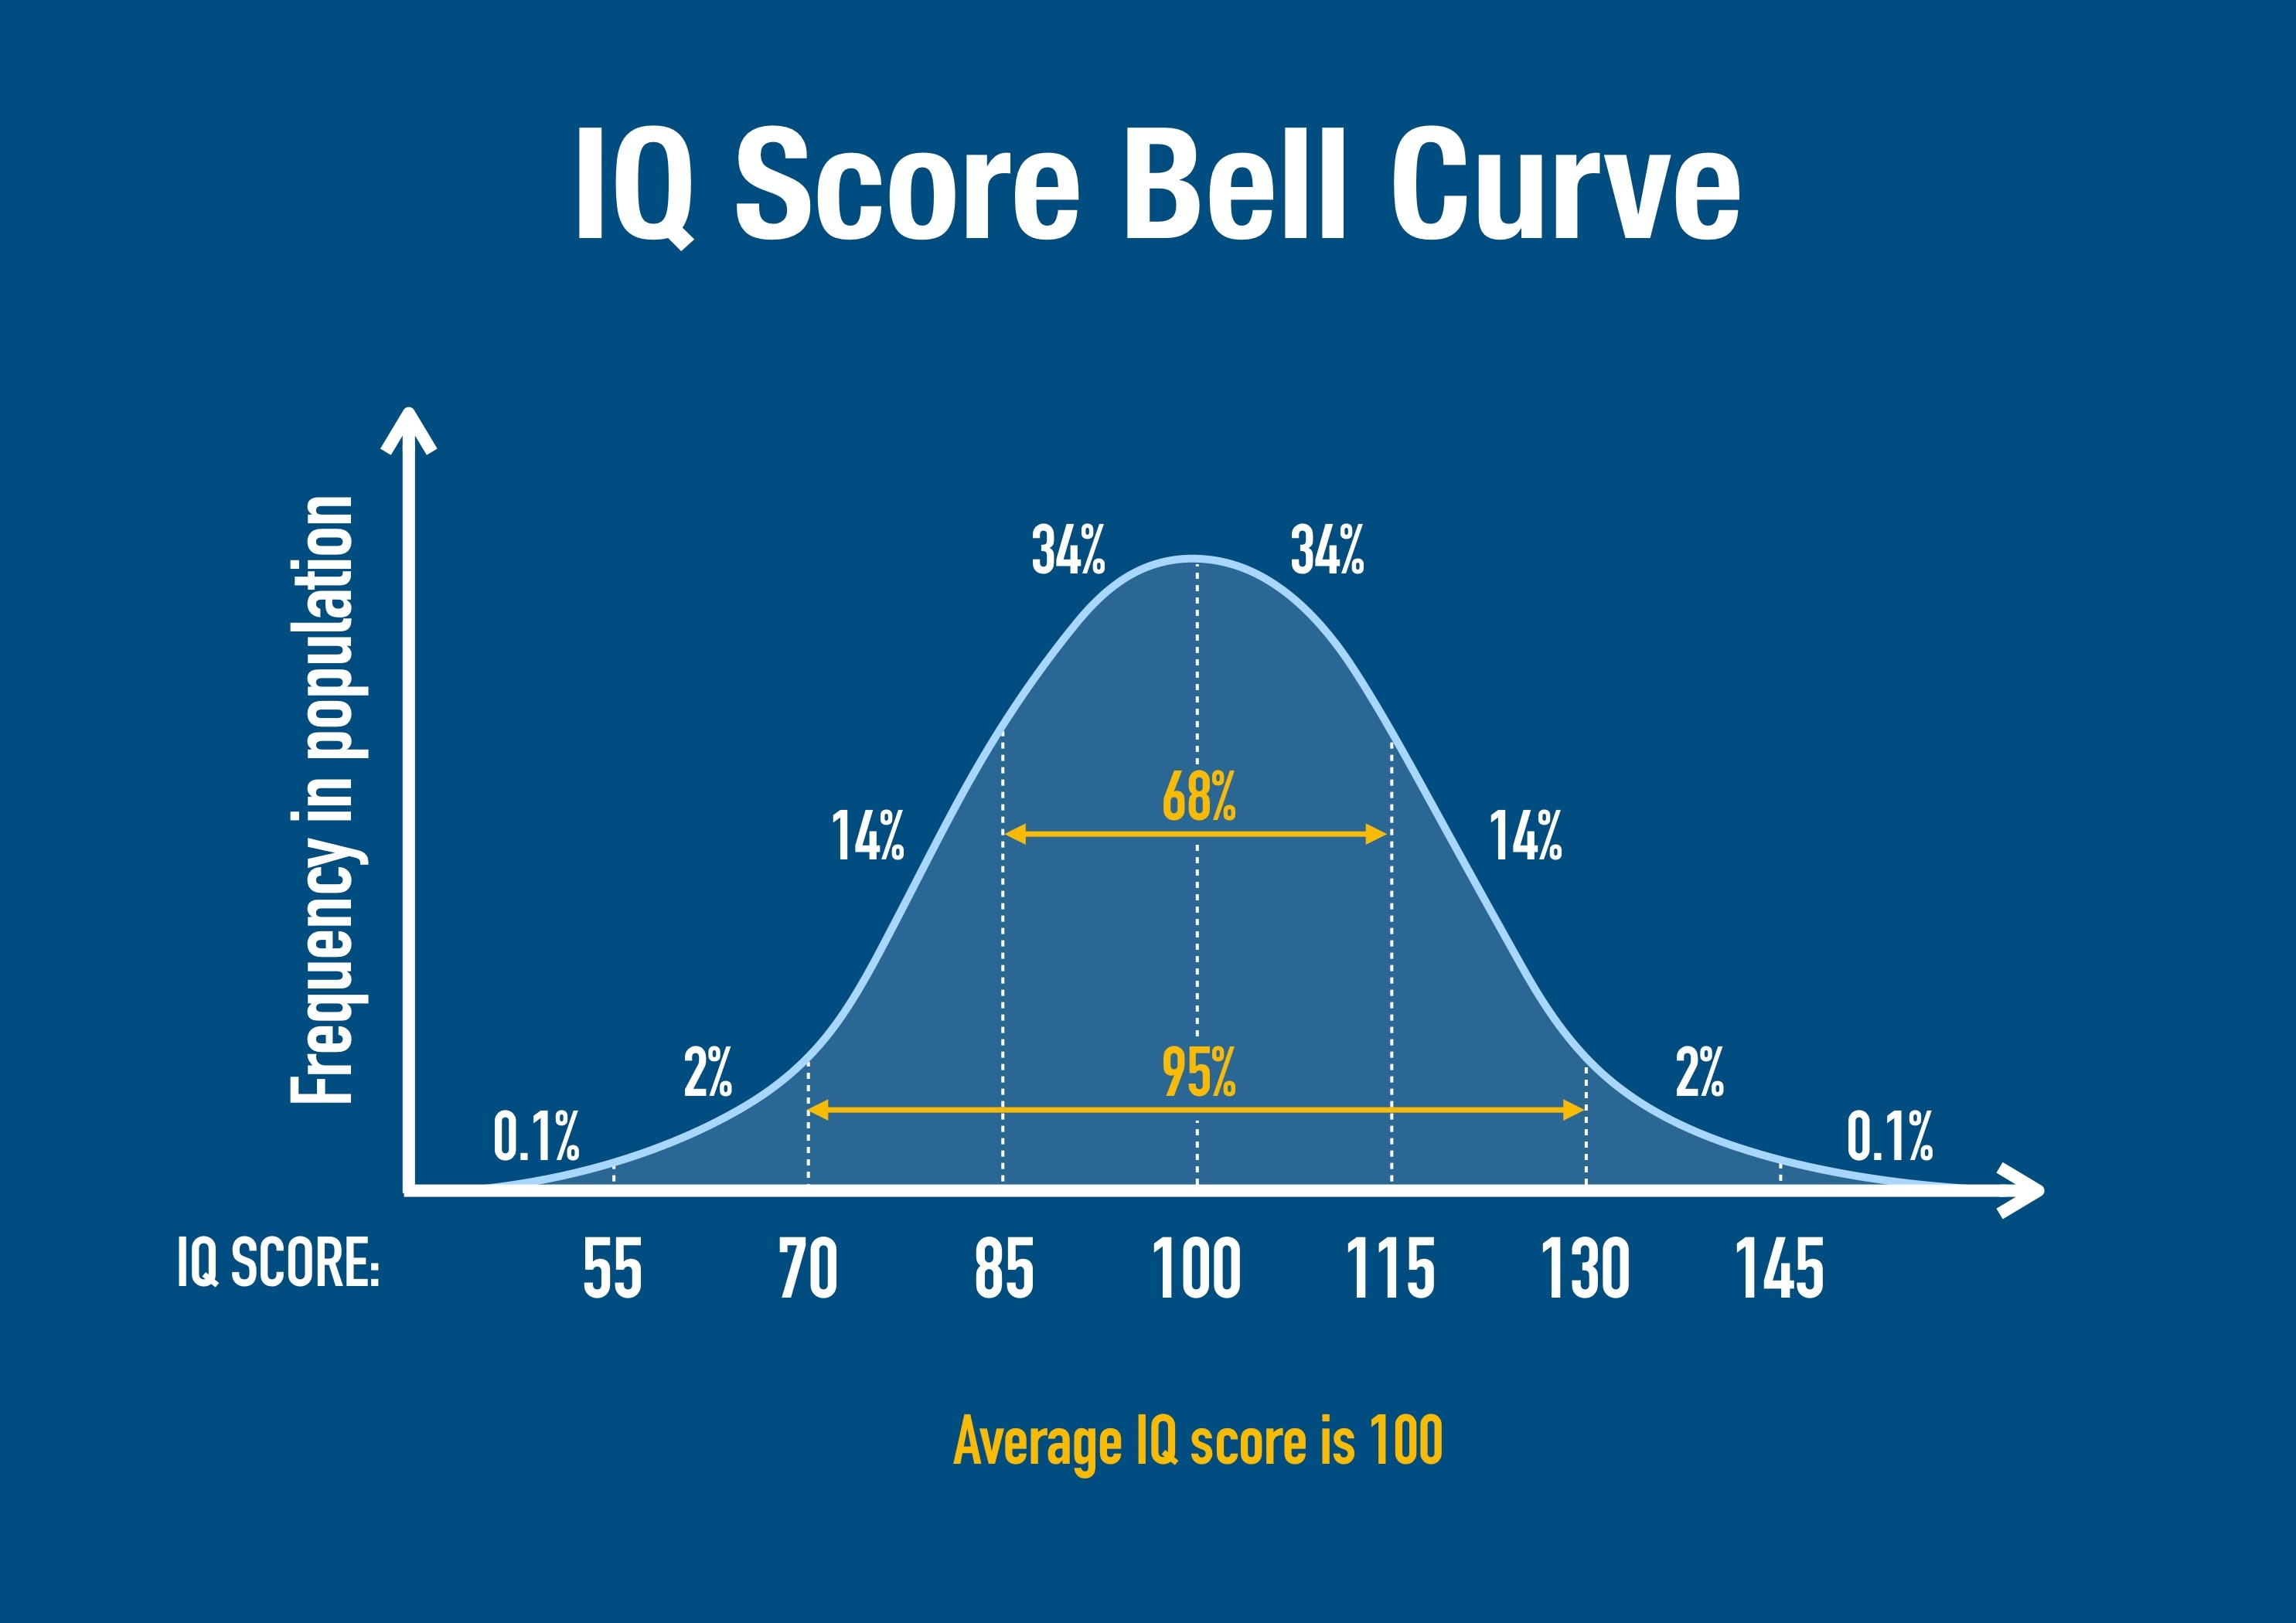
Continuous Random Variable:
A variable that can take on any value within a given range. These variables usually represent measurements. The possible values are infinite and uncountable.

Slide 36
What is a Probability Distribution?
A probability distribution is a function that describes the probability of a random variable taking on each of its possible values. It's the "rule" that tells you how likely different outcomes are.
For discrete random variables -- the probability distribution is a Probability Mass Function (PMF). It's a list or table that assigns a probability to each value of the random variable. The sum of all probabilities must be 1.
For continuous random variables -- the probability distribution is a Probability Density Function (PDF). Since the probability of any single value is zero, the PDF describes the probability of the variable falling within a certain range. The total area under the PDF curve is always 1.

