Slide 1
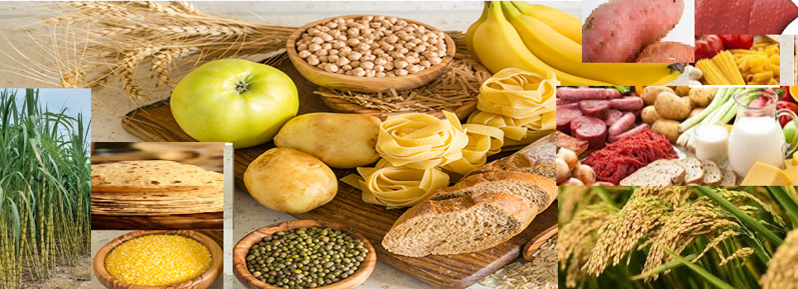

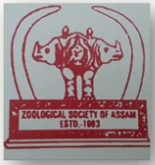
Carbohydrates-Structure and Biological importance
Delivered by
Dr. Rita Choudhury

Slide 2
1. Abundance of carbohydrates in living organisms.
2. Different classes of carbohydrates and their chemical structures.
3.Different isomeric forms of monosaccharide.
4. How monosaccharides are chemically linked to synthesize the oligosaccharides and polysaccharides.
5. Glycoconjugates and their roles in various cellular interactions.
6. Biological importance of carbohydrates.
Learning outcome- This ppt will help the students to know

Slide 3
What are carbohydrates
Carbohydrates are the most abundant biomolecules on earth.
Carbohydrates serve as a major source of energy required for the various metabolic activities of the living organisms.
Living organisms use carbohydrates as accessible energy to fuel cellular reactions, provide structural support to cell wall in plants, and conjugate with lipids and proteins for various cellular functions.
Carbohydrates are synthesized by the green cells of algae, plants and many protists by using CO₂ and water with the help of sun light energy through the process of photosynthesis.
In plants carbohydrates make up the bulk of living matter and about 80% of the dry weight of plant is made up of carbohydrates.
Animals cannot synthesize carbohydrate and hence depend on plants for its supply.

Slide 4
Chemical composition of carbohydrates
Carbohydrates consist of the elements carbon (C), hydrogen (H) and oxygen (O) with a ratio of hydrogen twice that of carbon and oxygen.
Many carbohydrates have the empirical formula (CH₂O)_{n} ,e.g. the most abundant simple carbohydrate, glucose has the molecular formula C₆H₁₂O₆ .However, in some cases carbohydrates also possess nitrogen, phosphorus or sulfur.
Chemically Carbohydrates are defined as polyhydroxy aldehydes or ketones. It is because of the occurrence in them of a carbonyl or carbon-oxygen(-C=O) group (aldo or keto) and many(at least two) hydroxyl groups.
These active groups of carbohydrates are responsible for their chemical behaviour.

Slide 5
Reducing and non reducing carbohydrates
Carbohydrates in which the aldehyde or ketone group remains free and is capable of acting as reducing agent, are called as reducing sugars. The common dietery monosaccharides like glucose, fructose and galactose and some disaccharides (latose, maltose) are reducing sugars.
On the other hand, the non reducing sugars do not have a free aldehyde or ketone group and cannot donate electrons to other molecules. Therefore, they cannot act as reducing agents. Sucrose is the most common non reducing sugar. Other examples are raffinose, trehalose, stachyose , verbacose, starch and cellulose.

Slide 6
Classification of carbohydrates
Depending on the chemical complexities, the carbohydrates can be divided into three major size classes. These are - monosaccharides, oligosaccharides and polysaccharides.
Monosaccharides or simple sugars consist of a single polyhydroxy aldehyde or ketone unit and are considered as the basic units of all carbohydrates.
Oligosaccharides consist of short chains of monosaccharide units, joined by characteristic glycosidic linkages. The most abundant are the disaccharides.
Polysaccharides are sugar polymers containing more than 20 or more monosaccharide units; some have hundreds or thousands of units.

Slide 7
Monosaccharides (Gr. monos = single, saccharon = sugar)
Monosaccharide are simplest carbohydrates, having general formula (CH₂O)_{n} and contains either an aldehyde group (an aldose) or a ketone group (a ketose) with two or more hydroxyl groups.
The most simplest monosaccharides are trioses (3 carbon sugars) such as glyceraldehyde and dihydroxyacetone.
. Glucose is the most abundant monosaccharide existing in nature, which is the main fuel in all cells. It is oxidized to get energy and cells draw it from the blood.
Monosaccharides are assigned to different categories according to the chemical nature of their carbonyl group and the number of their carbon atoms.

Slide 8
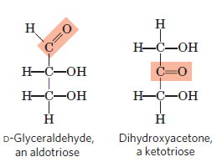
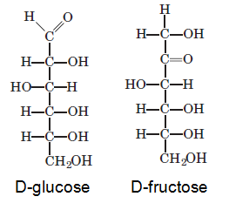
Families of monosaccharides
Based on the nature of carbonyl group, monosaccharides are classified into two families --
Aldoses : If the carbonyl group is at an end of the carbon chain that is in an aldehyde group, the monosaccharide is an aldose. eg. glyceraldehyde (an aldotriose) and D-glucose (an aldohexose).
Ketoses : If the carbonyl group is at any other position that is in a ketone group, the monosaccharide is a ketose. eg. dihydroxyacetone (a ketotriose) and D-fructose (a ketohexose).

Slide 9
Types of monosaccharide based on number of carbon atom
Monosaccharides with three, four, five, six, and seven carbon atoms in their backbones are called trioses (C₃H₆O₃) , tetroses (C₄H₈O₄) , pentoses (C₅H₁₀O₅) , hexoses, (C₆H₁₂O₆) and heptoses (C₇H₁₄O₇) respectively. The pentose and hexose sugars are biologically most important monosaccharides. Following are some examples of monosaccharide-
Sugars | Aldoses | Ketoses
Trioses (C₃H₆O₃) Tetroses (C₄H₈O₄) Pentoses (C₅H₁₀O₅) Hexoses (C₆H₁₂O₆) | Glycerose Erythrose Ribose Glucose | Dihydroxyacetone Erythrulose Ribulose Fructose
Heptose (C₇H₁₄O₇ ) | L-glycero-D-manno-heptose | Sedoheptulose

Slide 10
Isomerism in monosaccharides
Isomerism is the phenomenon in which more than one compounds have the same chemical formula but different chemical structures.
The chemical compounds that have identical chemical formulae, which means that they contain same number and same type of atoms, but differ in properties and the arrangement of atoms in the molecule are called isomers.
Monosaccharides in general contain one or more chiral or asymmetric carbon atoms, which means that the four functional groups attached to chiral carbon atom are different.
Thus monosaccharides can occur in optically active isomeric forms, referred to as stereoisomers.
As the D- glucose has four chiral centers, it can attain 2⁴ =16 possible stereoisomers. Of the 16 stereoisomers of glucose 8 are D forms and 8 are L forms.

Slide 11
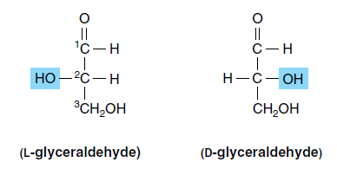
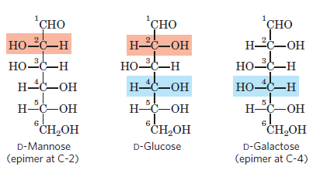
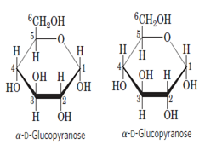
Isomeric forms of monosaccharides
ISOMERS
ENANTIOMER
DIASTERIAMER
EPIMER
ANOMER

Slide 12
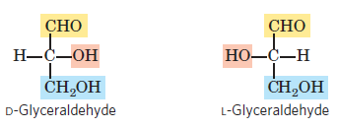
Enantiomers- Stereoisomers that are non-superimposable mirror images of each other are called enantiomers. The two different enantiomers of sugars are designated as
D and L, When the arrangement of the
hydroxyl group around the asymmetric
carbon is on the right side, the sugar is
the D isomer and when on the left side,
it is designated as the L isomer. Most of
the monosaccharides occurring in mammals are D sugars. In solution, glucose is dextrorotatory, hence the alternative name dextrose, often used in clinical practice.

Slide 13
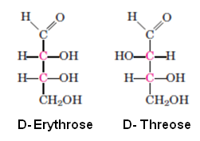
Diastereoisomers -When two sugars have
identical molecular formulas, have different
arrangement of atoms and are not enantiomers
are called diastereoisomers. Diastereoisomers
are of two types- epimers and anomers.
Epimers Sugars that differ only in the
configuration around one carbon atom
are called the epimers. D-glucose and
D-mannose are epimers, as they differ
only in the stereochemistry at C-2.
Similarly D-glucose and D-galactose are
epimers, which differ at C-4 position.
Diastereoisomers
Epimers

Slide 14
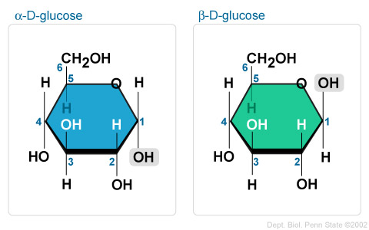
Anomers -They are diastereoisomers of cyclic forms of sugar molecules differing in the arrangement of H and OH only around the anomeric carbon (C-1 atom of an aldose or the C-2 atom of a ketose).The anomeric carbon is the carbon derived from the carbonyl carbon compound (the aldehyde or ketone functional group) of the open-chain form of the carbohydrate molecule.
The Cyclic forms of carbohydrates
can exist in two forms, α- and β-
based on the position of the
substituent at the anomeric center.
α-D-glucose and β-D-glucose are anomers
wikispaces.psu.edu

Slide 15
Structure of monosaccharides
The monosaccharides may be represented by two structures. They are-
1. Straight or open chain structure and
2. Cyclic or ring structure.
1.Straight chain structure –
In straight chain structure of 6 carbon D glucose (aldohexose), the atoms are arranged in a straight line.
It is also called open chain structure because the two ends remain separate and they are not linked.
Fischer’s projection formulas (proposed by Emil Fischer) are often used to represent three dimensional sugar structures in straight chain structure.

Slide 16
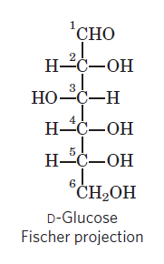
According to Fischer, the aldehyde group is placed at one end and the remaining carbon atoms are arranged one behind the other.
The last carbon atom contains two H atoms and one –OH group
(H₂OH).
The remaining carbon atoms contain H atom on one
side and OH group on the other side.
The carbon atoms are numbered from the aldehyde
group.
The carbon atom of the aldehyde group is the
carbon atom number 1 and the carbon atom
containing H₂OH is the carbon atom number
6 (in hexoses).

Slide 17
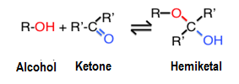
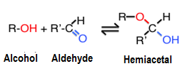
Cyclic structure or ring structure
In aqueous solution, aldotetroses and all monosaccharides with five or more carbon atoms in the backbone occur predominantly as cyclic (ring) structures.
In cyclic structures, the carbonyl group has formed a covalent bond with the oxygen of a hydroxyl group along the chain.
The formation of these ring structures is the result of a general reaction between alcohols and aldehydes or ketones to form derivatives called hemiacetals or hemiketals.

Slide 18
Formation of the two cyclic forms of D-glucose
D-glucose exists in solution as an intramolecular hemiacetal in which the hydroxyl group at C-5 has reacted with the aldehyde group at C-1 to form a hemiacetal linkage which makes carbon number-1 asymmetric, producing two possible stereoisomers, designated as α (alpha) and β (beta).
These α and β anomers differ only in the configuration of H and OH group around the anomaric carbon i.e. the carbon atom number 1 in case of glucose.
When the OH group on the anomeric carbon atom is below the plane of the ring, it is said to be in the α (alpha) position.
And when the OH group on the anomeric carbon is above the plane of the ring, the sugar is said to be in the β (beta) form.
.

Slide 19
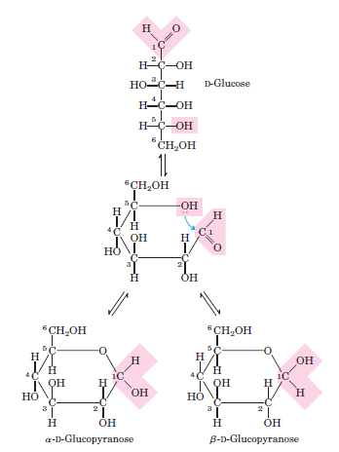
The interconversion of α and β anomeric forms in aqueous solution, via the open chain structure to give an equilibrium mixture is known as mutarotation. This reaction is reversible.
Thus, in an aqueous solution anomers freely interconvert from one form to another. As for example, in aqueous solutions of D-glucose the β anomer accounts for about 63% of the molecules present, the α form 36% and the open-chain form about 1 %.

Slide 20
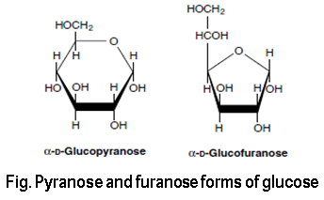
The sugar molecules exist in two types of rings- pyranose and furanose ring
Haworth perspective formulas are commonly used to show the stereochemistry of ring forms of monosaccharides.
The six-membered sugar ring that results
from reaction of an aldehyde group with
the hydroxyl group at C-5 is called a
pyranose ring and from the reaction of
an aldehyde group with the hydroxyl
group at C-6 is called a furanose ring.
Six-membered ring compounds are called pyranoses, because they resemble the six-membered ring compound pyran .

Slide 21
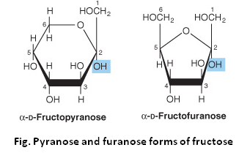
The systematic names for the two ring forms of D-glucose are therefore α-D-glucopyranose and β-D-glucopyranose.
Ketohexoses (such as fructose)also
occur as cyclic compounds with α
and β anomeric forms. In these
compounds the hydroxyl group at C-5
(or C-6) reacts with the keto group at
C-2, forming a furanose (or pyranose)
ring containing a hemiketal linkage.
In the ring structure, the 4 or 5 corners are occupied by the carbon atoms and one corner is occupied by the oxygen atom.

Slide 22
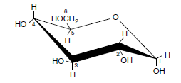
Chair conformation of Glucose–
In Haworth projection of glucose and other pyranoses the members of the ring are all depicted as lying in the same plane, though carbon atoms 2, 3 and 5 and the oxygen atom lie in the same plane to form the corners of the square, and carbon atoms 1 and 4 lie either above or below the plane.
Though, Haworth perspective formulas are commonly used to show
the ring forms of monosaccharides, however, the six membered
pyranose rings do not exist as planar
structures as Haworth perspectives
suggest. It tends to assume a chair
conformation, which is energetically
favored.
α-D-glucose chair form

Slide 23
Oligosaccharides (Gr. Oligos = few; saccharides = sugar)
An oligosaccharide consists of short chains of monosaccharides units (2 to 20) joined by glycosidic bond with the elimination of water.
The general formula of oligosaccharide is Cn(H₂O)n-1.
Depending on the number of monosaccharides, the oligosaccharides are classified as di-, tri-, tetra- saccharides etc. The most abundant oligosaccharides are the disaccharides.
Reducing oligosaccharides are formed when anomeric hydroxyl group is linked to alcoholic hydroxyl group of other monosaccharide.
Non reducing oligosaccharides are formed between anomeric hydroxyl groups of different monosaccharides.
The commonly found oligosaccharides in foods are maltose, sucrose, lactose, raffinose and stachyose.

Slide 24
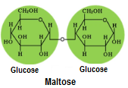
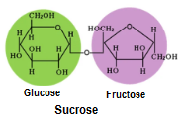
Disaccharides
Maltose : Maltose is a reducing sugar consisting
of two molecules of glucose bonded together by
Glycosidic linkage between carbon atom 1 and 4 of
the neighboring unit. It does not occur in natural
foods. It is produced by hydrolysis of starch.
Sucrose : Sucrose is the typical disaccharide and
it results from the union of a glucose molecule with
a fructose molecule between their 1 and 2 carbons.
It is a non reducing sugar, unlike its components.
Its glucose unit is in pyranose form and fructose unit is in furanose state. The two principal sources of sucrose are sugarcane and sugar beet.
Source-https://doi.org/10.1186/s40104-019-0345-6

Slide 25
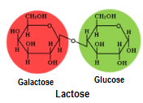
Lactose : Lactose is solely of animal origin. It is a component of mammalian milk consisting of one glucose and one galactose molecule joined by glycosidic bond. The linkage is formed between the glyosidic -OH group on the carbon atom 1 of galactose and the alcoholic OH group on the carbon atom 4 of glucose by the elimination of a molecule of water. Lactose is a reducing sugar and
it is the primary carbohydrate source for
developing mammals. It is hydrolysed by
the enzyme lactase in the gut.

Slide 26
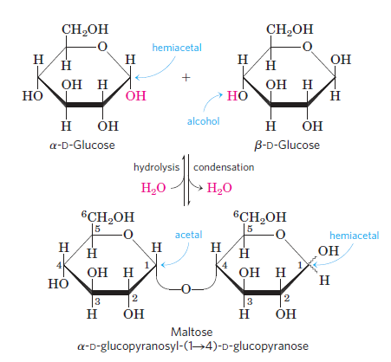
Formation of glycosidic linkage
Glycosidic linkage connects one sugar to the other. Glycosidic bonds between two monosaccharide units are a result of a condensation reaction.
In maltose, when an -OH (alcohol) of one
D-glucose molecule (right) condenses with the intramolecular hemiacetal of the other (left), then the glycosidic linkage is formed between the 1st carbon atom of one glucose and the 4th carbon atom of the second glucose with the elimination of H₂O molecule.

Slide 27
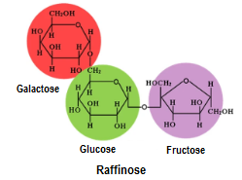
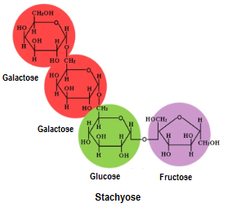
Raffinose is a trisaccharide composed of galactose, glucose, and fructose in which glucose acts as a monosaccharide bridge between galactose and fructose. It has both α and β glycosidic bonds. This trisaccharide is common in in beans, cabbage,
pumpkin, broccoli, asparagus and whole grains.
Stachyose is a tetrasaccharide consisting of two
galactose units, one glucose unit and one fructose
unit. It is recognized as a major storage and trans-
-port sugar in woody plants, cucurbits and legumes.
These two oligosaccharides are not fully digested
in humans due to lack of sufficient amount of the
enzyme alpha galactosidase.

Slide 28
Polysaccharides (Glycans )
Polysaccharides are high molecular weight substances composed of a large number of monosaccharide units (more than 20 or more) combined by glycosidic bond.
Most carbohydrates found in nature occur as polysaccharides.
Polysaccharides commonly found in foods are starch, dextrins, glycogen, cellulose, hemicellulose and pectin.
The number of monosaccharide units in a polysaccharide, which is termed as its degree of polymerization (DP), varies. Only a few polysaccharides have DPs less than 100; most have DPs in the range 200–3000.The larger one such as cellulose have a DP of 7,000–15,000.
Polysaccharides are two types- homopolysaccharides (homoglycans) and heteropolysaccharides (heteroglycans).

Slide 29
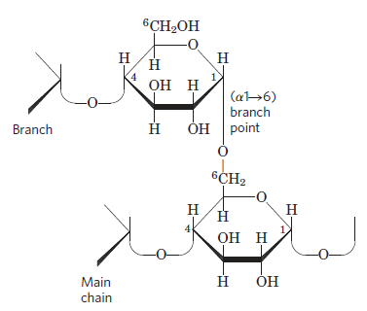
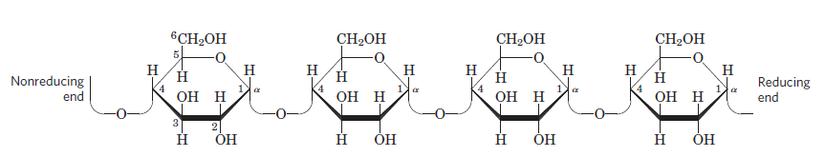
Homopolysaccharides
On hydrolysis, homopolysaccharides yield only one type of monosaccharides. Some common homopolysaccharides are-
Starch : They are the most important storage polysaccharides in plant cells. Starch contains two types of glucose polymer- amylose and amylopectine. Amylose consists of long chain of D-gluose residues connected by (α1→4) linkages . Amylopectine also has a backbone of (α1→4) linkages and the molecule is branched through (α1→6) linkages.
Amylose
Amylopectine

Slide 30
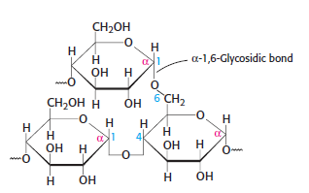
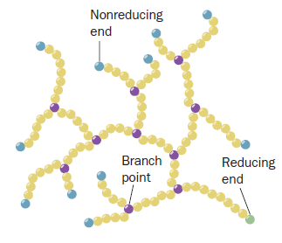
Glycogen : It is the main storage polysaccharide of animal cells. Glycogen
is a branched chain polysaccharide, two chains of glucose molecules
joined by (α1→4) glycosidic bonds are linked by an (α1→6) glycosidic
bond to create a branch point. Such an (α1→6)
glycosidic bond forms at approximately every 10
glucose units, making glycogen a highly
branched molecule.
The highly branched structure of glycogen,
which has many nonreducing ends, permits
the rapid mobilization of glucose in times of
metabolic need.
Glycogen occurs in 100- to 400-Å diameter
cytoplasmic granules which contain up to
120,000 glucose units.

Slide 31
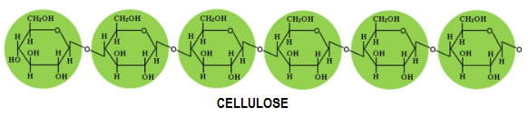
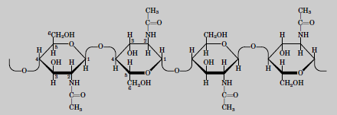
Cellulose : It is a fibrous, tough, water-insoluble substance found in the cell walls of plants. Cellulose consists of long unbranched chains of glucose residues joined
by α1→4 linkages which
are in β configuration.
Chitin : Chitin is the principal component of the hard exoskeletons of nearly a million species of arthropods. It is a linear homopolysaccha-
-ride composed of N-acetylglucosamine residues in β linkage. The only chemical difference from cellulose
is the replacement of the OH group
at C-2 with an acetylated amino
group.
Source-https://doi.org/10.1186/s40104-019-0345-6

Slide 32
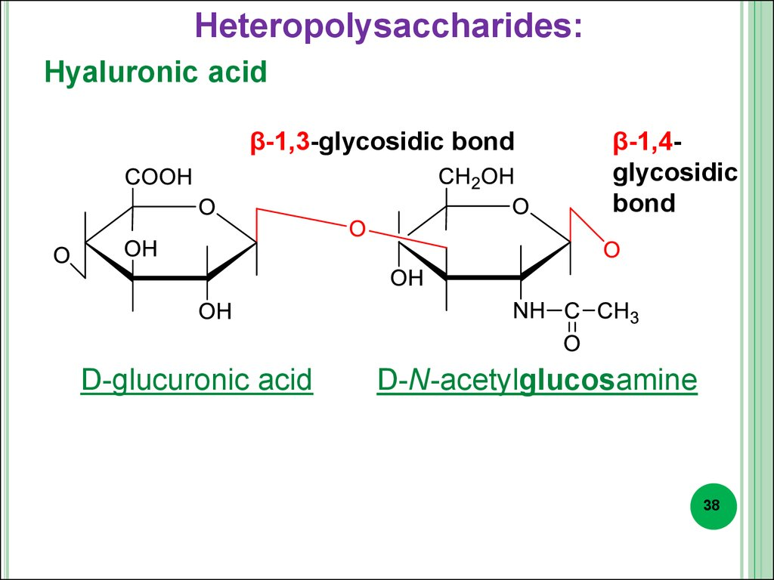
Heteropolysaccharides
Heteropolysaccharides are composed of
two or more different kinds of monosacch-
aride units. Examples- hyaluronic acid,
hemicellulose, heparin etc.
Hyaluronic acid molecules are composed
of 250 to 25,000 β (1 4)-linked disaccharide
units that consist of D-glucuronic acid and
N-acetyl- D-glucosamine linked by a β(1 3)
bond. It is an important glycosaminoglycans component found in
ground substance, synovial fluid of the joints, as a coating around
ovum and the vitreous humor of the eye. It also occurs in the capsules
surrounding certain, usually pathogenic, bacteria.
Source-pptonline.org

Slide 33
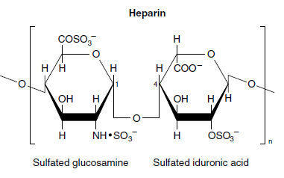
Hemicelluloses refer to substances which occupy the spaces between the cellulose fibers within the cell walls of plants. Hemicellulose is composed of pentoses (xylans), alternating units of mannose and glucose (mannans or glucomannans) or galactose units (galactans). They make up 20–35% of the dry weight of wood.
Heparin is a natural anticoagulant made
in mast cells (a type of leukocyte) and
released into the blood, where it inhibits
blood coagulation by binding to the protein
antithrombin. Heparin binding causes
antithrombin to bind to and inhibit
thrombin, a protease essential to blood clotting.

Slide 34
Glycoconjugates
Glycoconjugates are carbohydrates covalently linked to a non-sugar moiety such as a lipid or protein. They are often found on the outside of cell membranes and are involved in specfic recognition events between cells. They are of 3 types, viz-
1. Glycolipids,
2. Proteoglycans and
3. Glycoproteins
1. Glycolipids
Glycolipids are glycoconjugates where the carbohydrate is attached to a lipid.

Slide 35
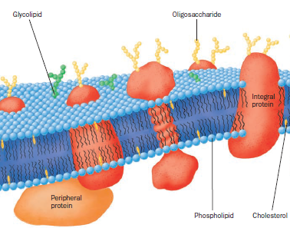
The combination of a polar carbohydrate and a non-polar lipid makes glycolipids very amphiphilic and they are almost always found in cell membranes, preferably on the outside.
In animals, the majority of glycolipids
are glycosphingolipids, where the
carbohydrate is attached to a
sphingoid base that is acylated with
a fatty acid.
Glycolipids maintain the stability of
the cell membrane and facilitate
cellular recognition, which is crucial
to the immune response.

Slide 36
Proteoglycans
Proteoglycans are macromolecules of the cell surface or extracellular matrix in which one or more glycosaminoglycan chains are joined covalently to a membrane protein or a secreted protein.
They consist of a core protein to which at least one glycosaminoglycan chain, most often keratan sulfate and/or chondroitin sulfate, is covalently linked.
Proteoglycans are major components of connective tissue such as cartilage, in which their many non covalent interactions with other proteoglycans, proteins, and glycosaminoglycans provide strength and resilience.
Mammalian cells can produce at least 30 types of molecules that are members of the proteoglycan super family.

Slide 37
Glycoproteins
Glycoproteins have one or several oligosaccharides of varying complexity joined covalently to a protein.
The carbohydrate portions of glycoprotein are often called glycans which generally occur as oligosaccharides.
They are found on the outer face of the plasma membrane, in the extracellular matrix, and in the blood.
Inside cells they are found in specific organelles such as Golgi complexes, secretory granules, and lysosomes.
Examples of Glycoproteins are Ribonuclease B, Thyroglobulin, Prothrombin, Fibrinogen, Interferon gamma, Mucins, Glycophorin etc.

Slide 38
Biological importance of carbohydrate
The primary functions of carbohydrates are-
Energy source - Carbohydrates are the main energy source of the human diet, as their oxidation is the major source of energy in nonphotosynthetic cells. Example: glucose, sucrose, fructose. Glucose is the principal fuel for the brain. When the amount of glucose reaching the brain is too low, the consequences can be lethargy, coma, permanent brain damage, and death.
Storage energy -Plants store their energy in the form of starch whereas animals store their energy for short term in the form of glycogen. The glycogen stored in liver, controls glucose level in the blood.
Part of DNA and RNA - Deoxyribose and ribose sugars form a component of genetic material like DNA and RNA.

Slide 39
4. Structural component –Carbohydrates serve as important structural material in plants and some animals. E.g-Cellulose is the major comp-
-onent of plant cell wall, chitin forms the exoskeletons of arthropods and fungal cell wall and peptidoglycan is the rigid component of bacterial cell wall and protects the cell from lysis.
5. Glycoconjugates -These are specific carbohydrate containing molec-
-ules act in cell-cell recognition and adhesion, cell migration during development, blood clotting, the immune response, wound healing etc. They serve as destination labels for some proteins and as mediators of specific cellular interactions.
6. As information molecule- Cells use specific oligosaccharides of glycoproteins or glycolipids to encode important information for intracellular targeting of proteins, cell-cell interaction and extracellular signals.

Slide 40
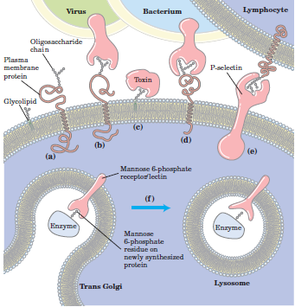
Roles of oligosaccharides in recognition and adhesion
The oligosaccharides of plasma membranes interact with the extracellular milieu in the following ways-
(a) Viruses bind to cell surface glycoproteins for its infection.
(b) Bacterial toxins (e. g. cholera toxins), bind to a surface glycolipid before entering a cell.
(c) Selectins in the plasma membrane of certain cells mediate cell-cell interactions.
(d) The mannose 6-phosphate receptor of the trans Golgi complex binds to the oligosacch-
-aride of lysosomal enzymes,
Source-Lehninger Principles of Biochemistry

Slide 41
Bibliography
David, L. Nelson and Michael M. Cox. (2013).Lehninger Principles of. Biochemistry. Sixth Edition. W. H. Freeman and Company. Pp 243-280.
Murray, R.K., Bender, D.A., Botham, K.M., Kennelly, P.J., Rodwell, V.W. and Well, P.A. (2003). Harper’s Illustrated Biochemistry, 26 th Edition, International Edition, The McGraw- Hill Companies Inc. Pp 102-110.
Hames, B.D. & Hooper N.M. (2000).Instant Notes in BIOCHEMISTRY 2nd Edition. BIOS Scientific Publishers Limited. UK. Pp 267-305.
Berg, J.M., Tymoczko, J.L. and Stryer, L. (2007). Biochemistry, VI Edition, W.H. Freeman and Co., New York. Pp 303-319.
Navarro, D.M.D.L., Abelilla, J.J. & Stein, H.H. (2019). Structures and characteristics of carbohydrates in diets fed to pigs: a review. J Animal Sci Biotechnol 10, 39 https://doi.org/10.1186/s40104-019-0345-6.
Sinnott , M. (2013). Carbohydrate chemistry and biochemistry: structure and mechanism. 2nd ed. Cambridge: The Royal Society of Chemistry.

Slide 42
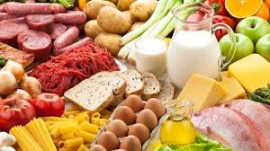

THANK YOU
Email -choudhuryrita01@gmail.com

